Slide 1
COVID SPREAD ANALYSIS
Task 2: Mentorness Data Analyst Intern

Slide 2
Overview:
The CORONA VIRUS pandemic has had a significant impact on public health and has created an urgent need for data-driven insights to understand the spread of the virus. As a data analyst, you have been tasked with analyzing a CORONA VIRUS dataset to derive meaningful insights and present your findings.

Slide 3
Dataset:
Description of each column in dataset:
Province: Geographic subdivision within a country/region.
Country: Geographic entity where data is recorded.
Latitude: North-south position on Earth's surface.
Longitude: East-west position on Earth's surface.
Duration: Recorded date of CORONA VIRUS data.
Confirmed: Number of diagnosed CORONA VIRUS cases.
Deaths: Number of CORONA VIRUS related deaths.
Recovered: Number of recovered CORONA VIRUS cases.

Slide 4
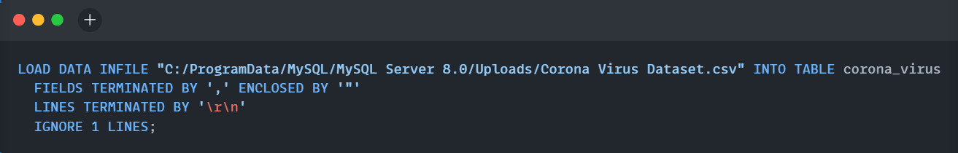

Loading the csv file in the database table
Data Successfully Loaded

Slide 5
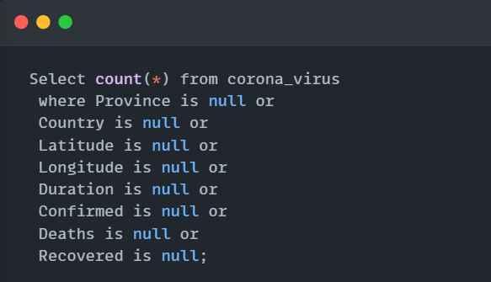

-- Q1 Write a code to check NULL values

Slide 6
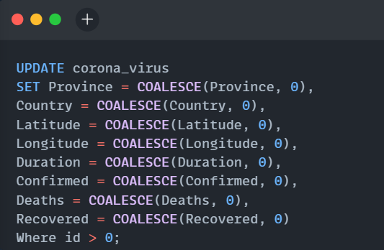
-- Q2. If NULL values are present, update them with zeros for all columns.

Slide 7
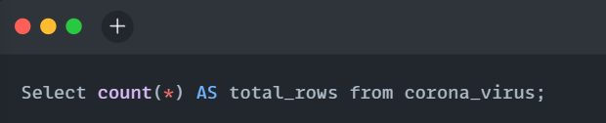

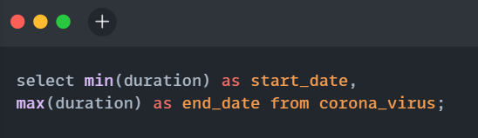

-- Q3. check total number of rows
-- Q4. Check what is start_date and end_date

Slide 8
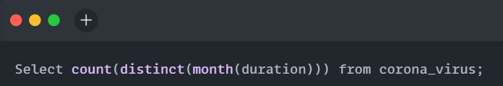

-- Q5. Number of month present in dataset

Slide 9
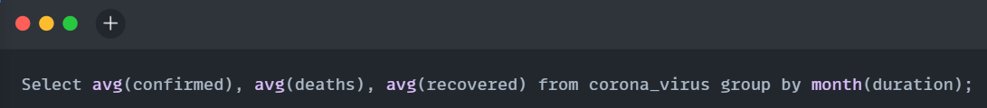
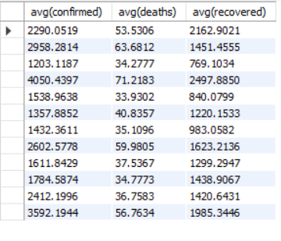
-- Q6. Find monthly average for confirmed, deaths, recovered

Slide 10
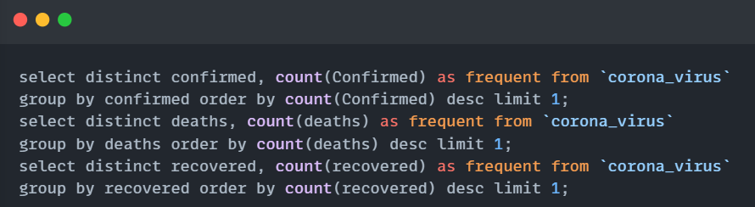



-- Q7. Find most frequent value for confirmed, deaths, recovered

Slide 11
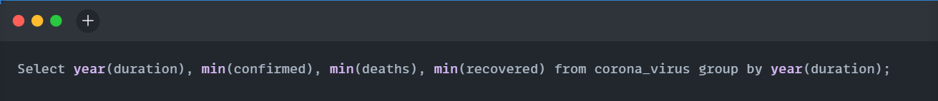

-- Q8. Find minimum values for confirmed, deaths, recovered per year

Slide 12
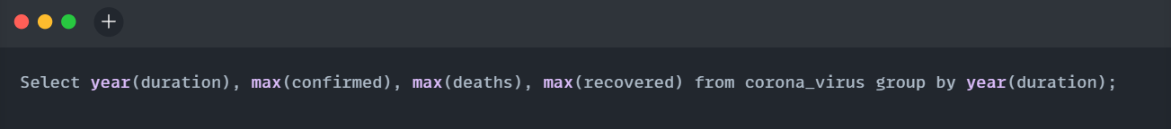

-- Q9. Find maximum values of confirmed, deaths, recovered per year

Slide 13
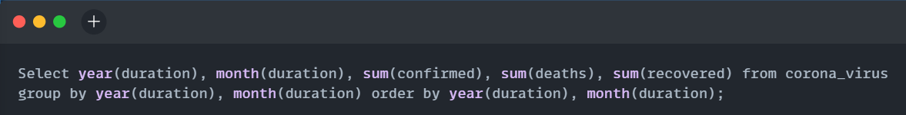
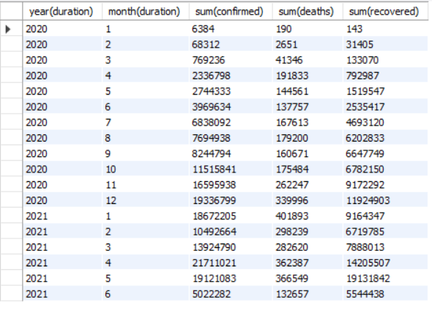
-- Q10. The total number of case of confirmed, deaths, recovered each month

Slide 14
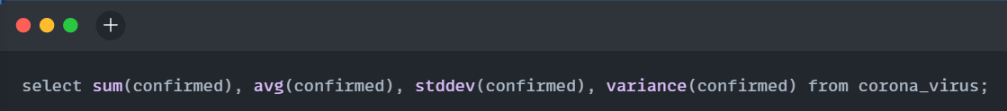

-- Q11. Check how corona virus spread out with respect to confirmed case

Slide 15
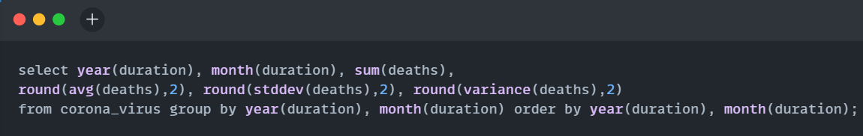
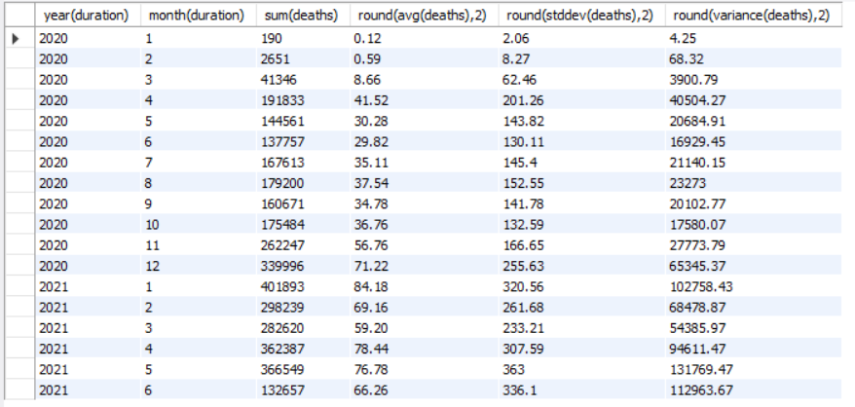
-- Q12. Check how corona virus spread out with respect to death case per month

Slide 16
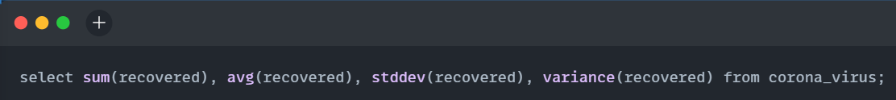
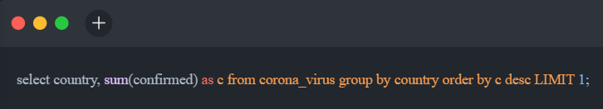

-- Q13. Check how corona virus spread out with respect to recovered case
-- Q14. Find Country having highest number of the Confirmed case

Slide 17
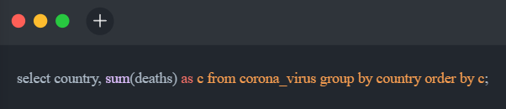
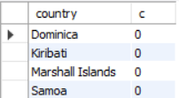

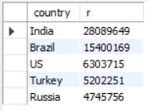
-- Q15. Find Country having lowest number of the death case
-- Q16. Find top 5 countries having highest recovered case

Slide 18
THANK YOU

